Slide 1
Storytelling-Section 6
File created on: 7/11/2022 5:49:01 PM

Slide 2
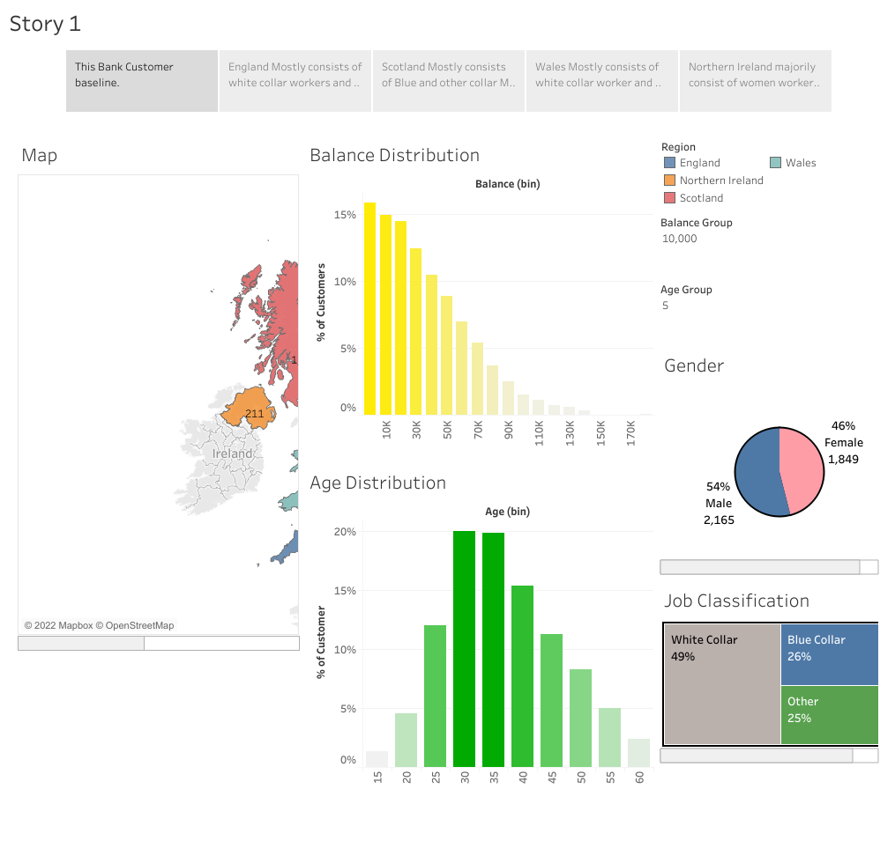

Slide 3
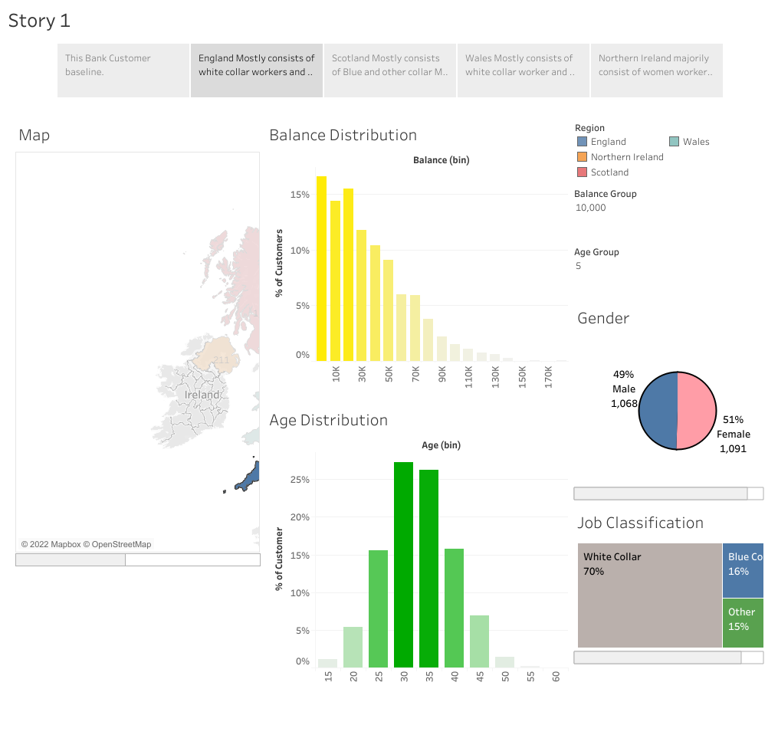

Slide 4
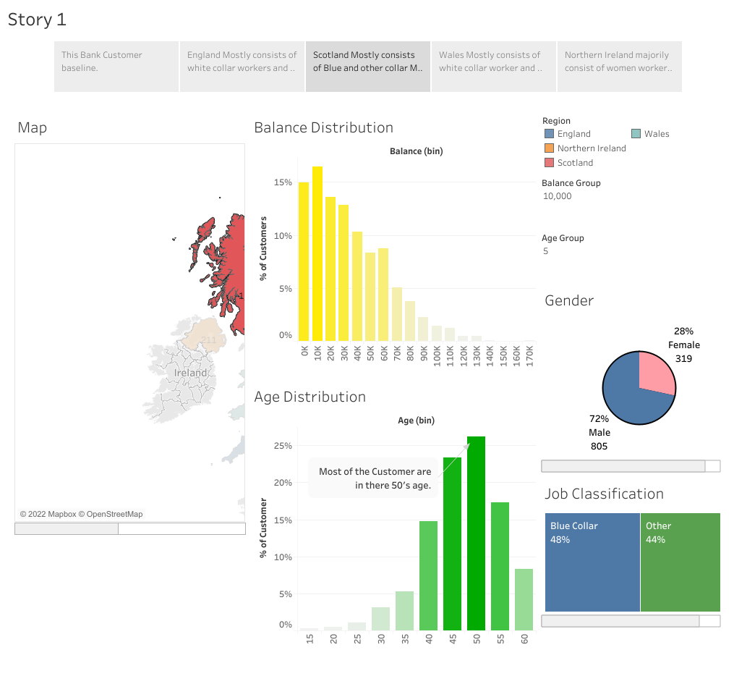

Slide 5
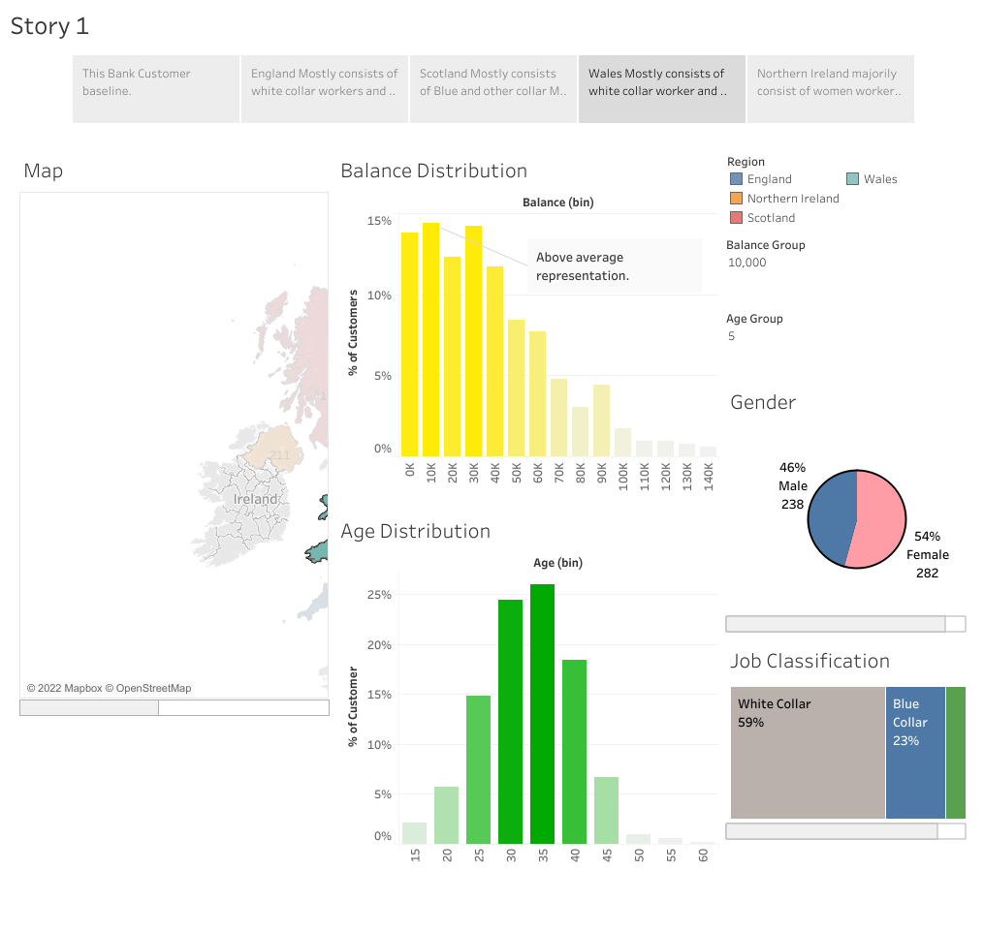

Slide 6
